Slide 1

PDA Guidance
Professional Development Award in Software Development

Slide 2
Focus
Covering material specifically needed for the PDA
Google is not your friend when it comes to the PDA
Standardized approach = pass/fail criteria
Copy of this guidance in repo

Slide 3
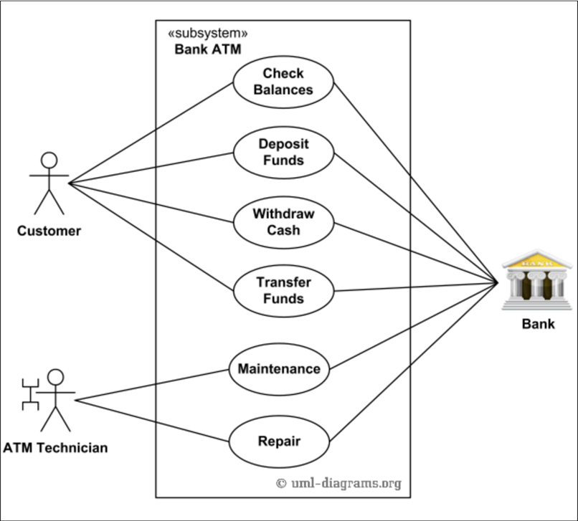
Use Case Diagram
Use case diagrams give an overview of the usage requirements for a system.
Use case diagrams depict:
Use cases (actions)
Actors
Associations
System boundary boxes (optional)

Slide 4
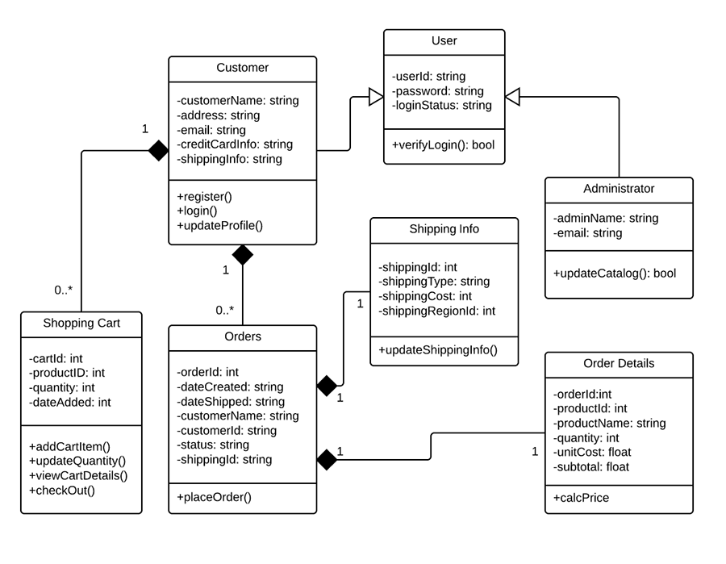
Class Diagram
Class diagrams describe the structure of a system by showing the system's classes, their attributes, methods and the relationships.
Class diagrams should include:
Name of each class
Attributes of each class
Type of each attribute
Methods
Relationships

Slide 5
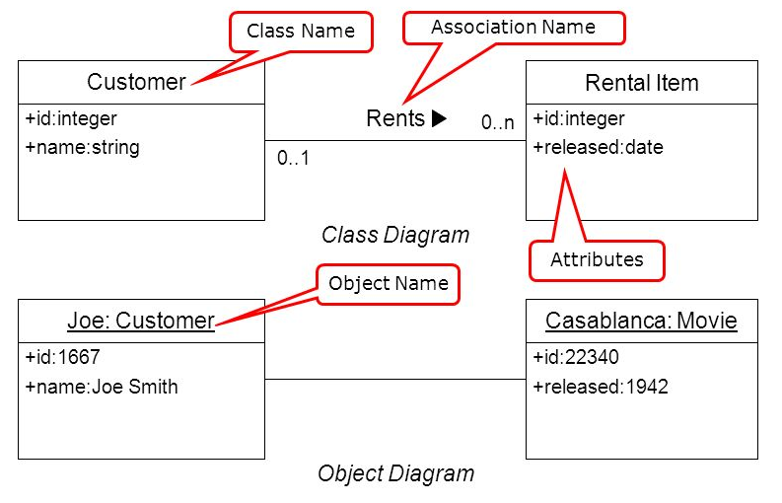
Object Diagram
Object diagrams provide examples or act as test cases for class diagrams.
Object diagrams should include:
Name of the class
Instance of that class
Attributes of each class
Type of each attribute replaced with an example
Relationships

Slide 6
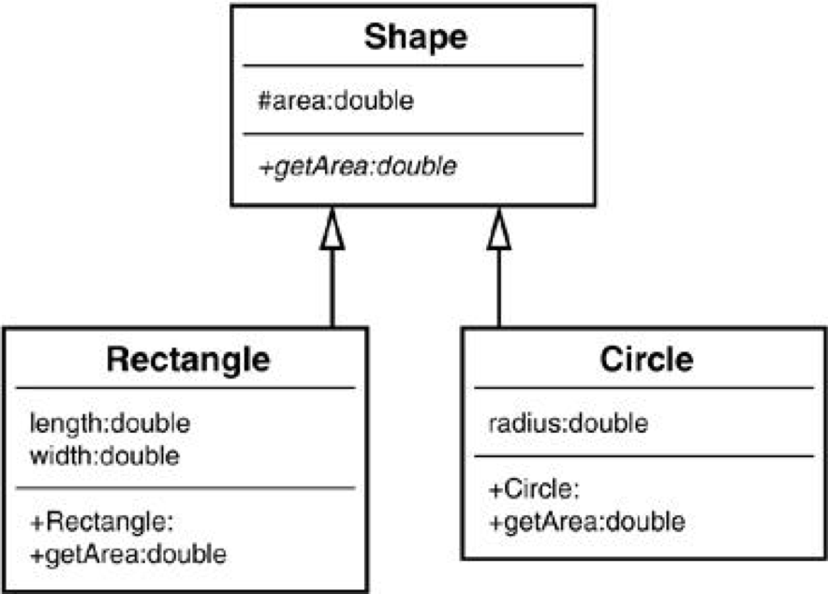
Inheritance Diagram
An inheritance diagram demonstrates when a child object assumes characteristics of its parent object.
Inheritance diagrams should include:
Relationships (using arrows)
Name of the class
Attributes of each class
Type of each attribute
What is inherited

Slide 7
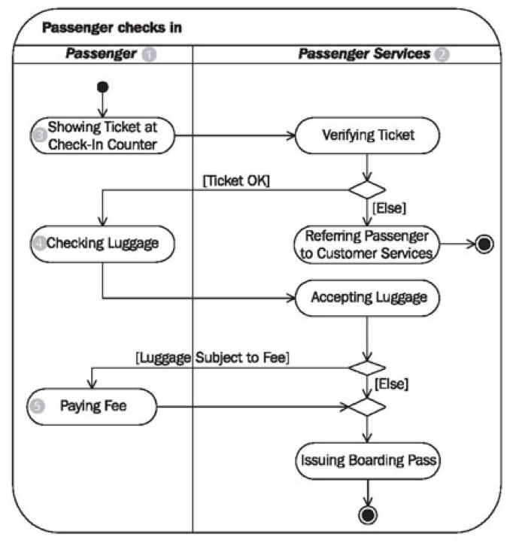
Activity Diagram
An Activity Diagram is a flow chart to represent the flow from one activity to another activity.
This helps to plan what is needed in the system and how it should be structured.
Activity diagrams should include:
lines with arrows
rounded rectangles (actions)
diamonds (decisions)
black circle (start of the workflow)
encircled black circle (the end)

Slide 8
Implementation Constraints Plan
Implementation constraints are things that might constrain the project and stop it from reaching its full potential.
Constraint Category | Implementation Constraint | Solution
Hardware and Software Platforms | What could be a constraint on the product? How it could be a constraint of the product? Why is it a problem? | How the constraint will be avoided or how it is not a consideration.
Performance Requirements
Persistent Storage and Transactions
Usability
Budgets
Time Limitations

Slide 9
Acceptance Criteria and Test Plan
An Acceptance Criteria is a set of statements with a clear pass/fail result. Acceptance Criteria should state intent, but not a solution.
An Acceptance Test Plan is the final two columns of this table.
Acceptance Criteria | Expected Result/Output | Pass/Fail
A user is able to… | The …. does… when… | Pass/Fail

Slide 10
System Interaction Diagrams
System interaction diagrams look at the flow of control and data among the things in the system.
There are two types of system interaction diagrams:
Sequence Diagrams: More information at http://www.ibm.com/developerworks/rational/library/3101.html
Collaboration Diagrams : More information at http://www.ibm.com/developerworks/rational/library/3101.html

Slide 11
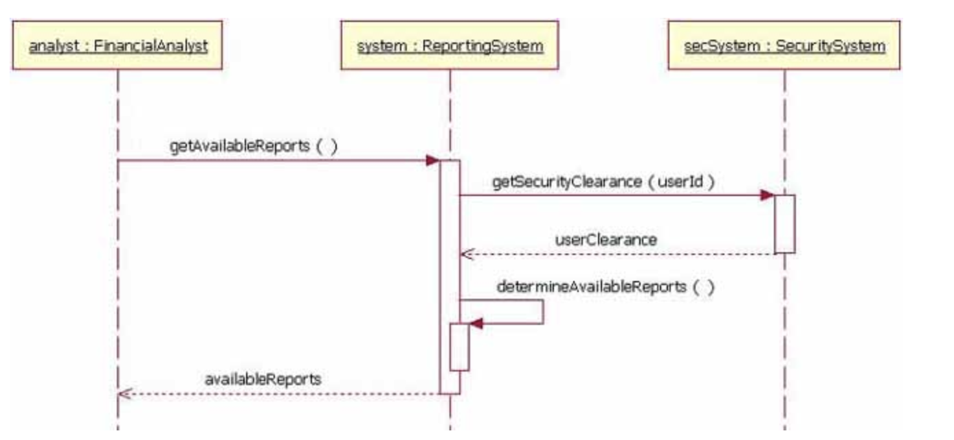
Sequence Diagram
The behaviour of objects in a use case by describing the objects and the messages they pass.
Order in which messages occur
What messages are sent between a system's objects

Slide 12
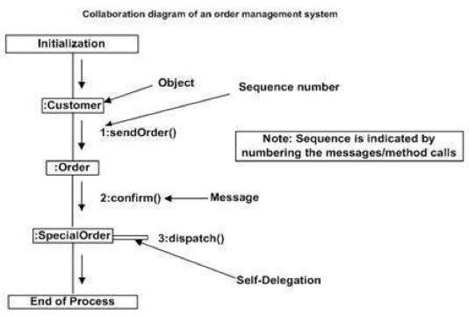
Collaboration Diagram
Collaboration diagrams show the structural organization of objects taking part in the interaction.
Relationship between objects
The order of messages passed between them

Slide 13
Bug Tracking Report
A Bug Tracking Report is a record of all the bugs that occur in the process of building a Software Product.
For the PDA you must include 5-6 examples of “bugs” or errors.
Bug/Error | Solution | Date

Slide 14
Remember…
DO NOT GOOGLE PDA DIAGRAMS
Use the resources provided
Keep on top of the PDA as you go through the course

